Slide 1

MongoDB
Group 6
Aayush Mandhyan
Sagar Jain
Amit Patil

Slide 2

Planning the Process
Denormalized the Tables
Convert the CSV File To JSON Format
Push the JSON file Into MongoDB

Slide 3
Setup Procedure
Denormalized the tables using join in stored procedure to form a final table.
Retrieve .csv from MySQL.
Using pandas convert .csv to .json format in python.
Installed MongoDB on GCP instance.
Created bucket in GCP and pushed .json to the bucket.
Pulled .json data from bucket to linux instance.
Used mongoimport to load .json data in MongoDB

Slide 4

Queries
Limit
Count
Remove
Sort
Update

Slide 5
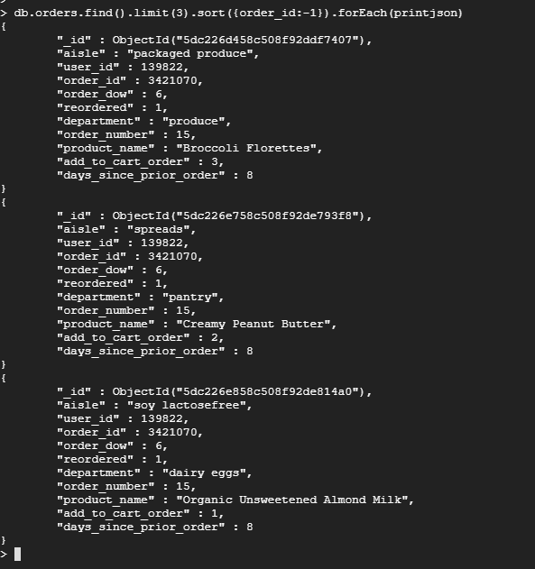
Setup Procedure
Limit()

Slide 6
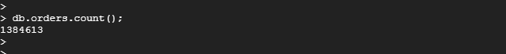
Setup Procedure
Count()

Slide 7
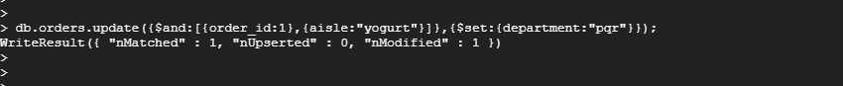
Setup Procedure
Update()

Slide 8
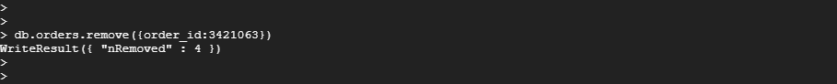
Setup Procedure
Remove()

Slide 9
Setup Procedure
Sort()

Slide 10

Thank you!

